Slide 1
Data Mining in Academic Databases to Detect Behaviors of Students Related to School Dropout and Disapproval
WorldCist'16
March, 22-24, Recife, Brazil

Slide 2
Data Mining in Academic Databases to Detect Behaviors of Students Related to School Dropout and Disapproval
Schedule
Introduction;
School Dropout and Disapproval;
School Dropout at the Federal Institutions Network;
The Dropout in IFRN (Campus Natal-Cetral) from 2000 to 2013;
Data Mining Application in IFRN Database.

Slide 3
Data Mining in Academic Databases to Detect Behaviors of Students Related to School Dropout and Disapproval
Introduction
The problem of dropout and school failure in federal institutions has generated some challenges to overcome. The high incidence related to these factors, it has been lived in the practical experience of all educators that make education in these institutions. It is known in advance that school dropout and school disapproval are associated with factors such: areas of knowledge of students, educational levels and specific methodologies of teaching and learning.

Slide 4
Data Mining in Academic Databases to Detect Behaviors of Students Related to School Dropout and Disapproval
School Dropout and Disapproval;
The problem of school dropouts in Brazil is not a recent problem, but rather a repeat offender. It is one, of the factors, that concerns educators and public policy makers in our country. According to the Ministry of Education (MEC), school dropouts reaches 6.9% in primary and 10% in high school (3.2 million children and young people, according to data of 2005). There are over 2.9 million students [14] who leave school a year and return the next, thickening other disturbing content: the level-age distortion.

Slide 5
Data Mining in Academic Databases to Detect Behaviors of Students Related to School Dropout and Disapproval
School Dropout at the Federal Institutions Network;
Data released in accordance with [17], Brazil is one of the countries most disapprove. In high school the rate reaches 13.1%. Are almost $ 3 billion / year spending beyond what is necessary, only in the final years of schooling. The worst is that, as shown in qualitative and quantitative research, there is great relationship between repetition and dropout. No wonder that the study recently published by the "Education for All" shows that only 54% of young Brazilians manage to graduate from high school up to 19 years. Of young people between 15 and 17, one in five still in elementary school, accumulating failures. And 15.7% dropped out, certainly after school failure experiences [17].

Slide 6
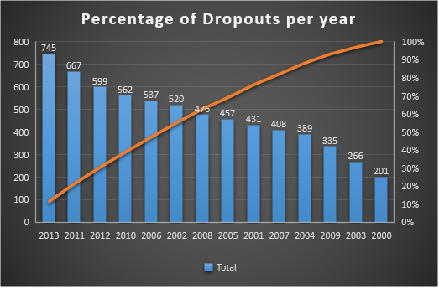
Data Mining in Academic Databases to Detect Behaviors of Students Related to School Dropout and Disapproval
The Dropout in IFRN (Campus Natal-Cetral) from 2000 to 2013;

Slide 7
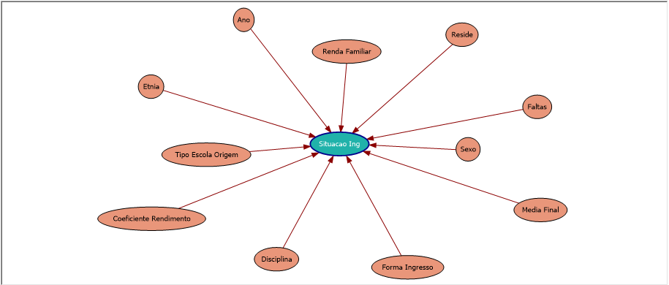
Data Mining in Academic Databases to Detect Behaviors of Students Related to School Dropout and Disapproval
Data Mining Application in IFRN Database
Network Decision Tree showing the relationships between attributes. Tool used to create the chart was Microsoft Analysis Services
This tree shows the attributes that influence the dropout situation.

Slide 8
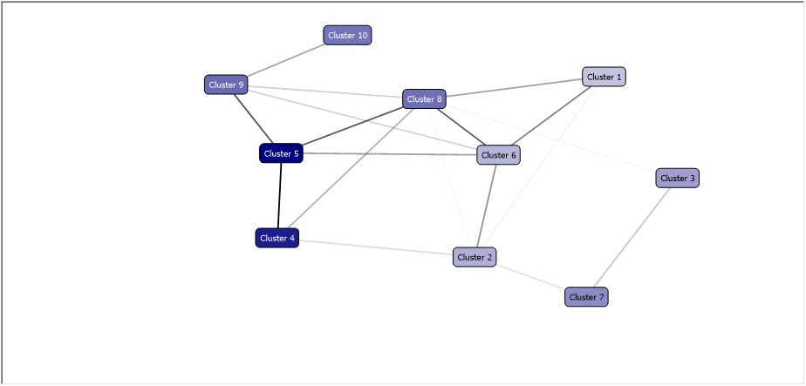
Data Mining in Academic Databases to Detect Behaviors of Students Related to School Dropout and Disapproval
Data Mining Application in IFRN Database
Figure shows the Cluster chart that the highest concentration of cases of dropout, are precisely those with the most intense blue color and the clusters with fewer cases of evasion, are those with a less intense color.

Slide 9
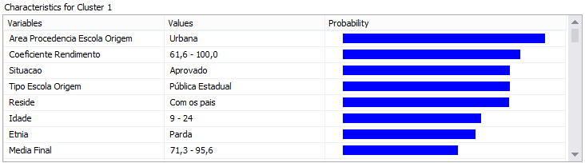
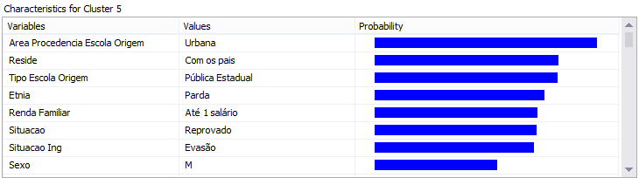
Data Mining in Academic Databases to Detect Behaviors of Students Related to School Dropout and Disapproval
Data Mining Application in IFRN Database
The cluster 1 shows that the profile of successful students are those with final average above 70, GPA above 60, coming from public school, live with their parents and brown ethnicity.
Observing the cluster 5 characteristics: it is clear that in cluster formation 5, family income (up to 1 salary) and the situation (deprecated), appear as factors influencing school dropout.

Slide 10
Data Mining in Academic Databases to Detect Behaviors of Students Related to School Dropout and Disapproval

